Slide 1
Lecture 32 – Warshall’s Algorithm
CST370 – Design & Analysis of Algorithms
Dr. Byun
Computer Science

Slide 2
Lecture Objectives
After completion of this lecture, you will be able to
  explain the meaning of transitive closure of a directed graph.
  calculate the transitive closure using the Warshall’s algorithm.

Slide 3
Chapter 8: Dynamic Programming
8.1 Three Basic Examples
8.2 The Knapsack Problem and Memory Functions
8.3 Optimal Binary Search Trees
8.4 Warshall’s and Floyd’s Algorithms

Slide 4
Warshall’s Algorithm
Warshall’s algorithm is an algorithm to compute the transitive closure of a directed graph.
  In other words, the algorithm checks if a path exists between two vertices of a directed graph.

Slide 5
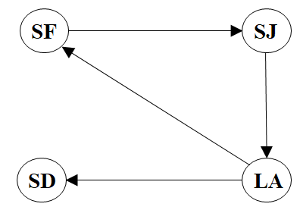
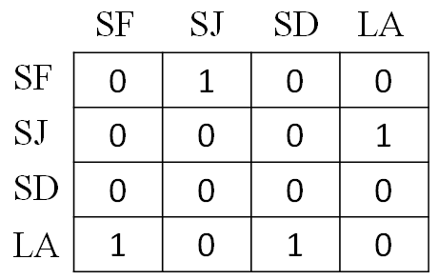
Example (1 of 2)
Is there a path from SF to SD?
  How about from SF to LA?
  Then, how about from SD to SJ?

Slide 6
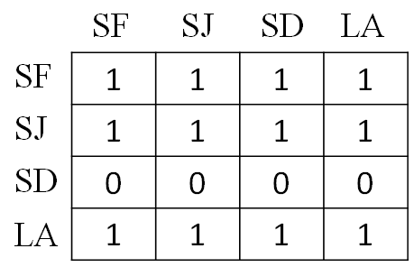
Example (2 of 2)

Slide 7
Warshall’s Algorithm – Introduction
Warshall’s algorithm is to compute the transitive closure of a directed graph.
To learn the basic concept of transitive closure and Warshall’s algorithm, watch this video from 3:00 to 9:13.
  http://y2u.be/hKCqske0rAE

Slide 8
Warshall’s Algorithm – Basic Idea
Assume that we have n nodes.
We calculate n-by-n matrices R⁽⁰⁾, R⁽¹⁾, R⁽²⁾, R⁽³⁾, … R^{(n)} where R^{(k)}[i, j] = 1 if and only if there is a path from i to j with only first k vertices allowed as intermediate nodes.

Slide 9
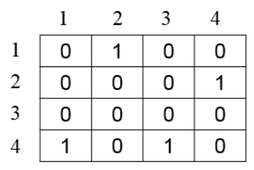
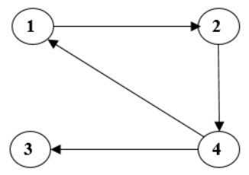
Example (1 of 5)
R⁽⁰⁾=

Slide 10
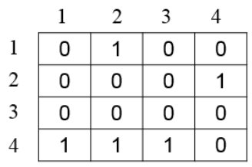
Example (2 of 5)
R⁽¹⁾=

Slide 11
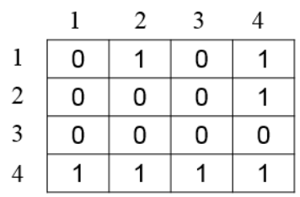
Example (3 of 5)
R⁽²⁾=

Slide 12
Example (4 of 5)
R⁽³⁾=

Slide 13
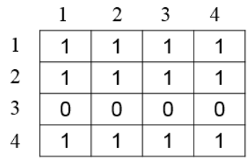
Example (5 of 5)
R⁽⁴⁾=

Slide 14
Warshall’s Algorithm – Introduction
Read the Google document below to completely understand the basic operation of the Warshall's algorithm.
  https://goo.gl/zthtJA

Slide 15
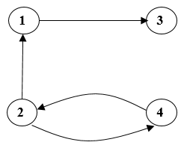
Exercise (1 of 4)
Assume that we have the following directed graph.
  Present R⁽⁰⁾, R⁽¹⁾, R⁽²⁾, R⁽³⁾, and R⁽⁴⁾ as we discussed in the Google document.

Slide 16
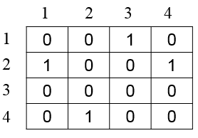
Exercise (2 of 4)
R⁽⁰⁾=

Slide 17
Exercise (3 of 4)

Slide 18
Exercise (4 of 4)

Slide 19
Recurrence of Warshall’s Algorithm

Slide 20
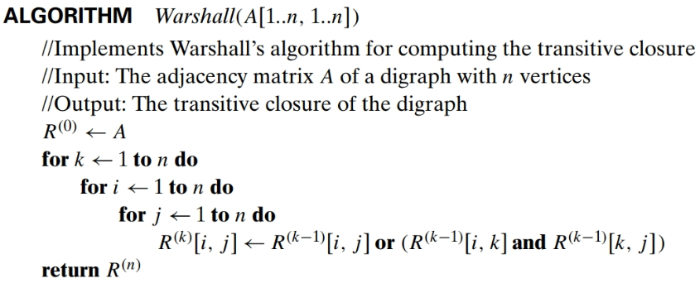
Pseudocode of Warshall’s algorithm

